Slide 2
Objectives
Explain functions
Explain parameterized functions
Explain return statement
Describe objects
Explain different browser objects
Describe Document Object Model (DOM)

Slide 3
Functions
Is an independent reusable block of code that performs certain operations on variables and expressions to fulfill a task.
Might accept parameters, which are variables or values on which it performs operations.
Might return the resultant value to display it in the browser after the operations have been performed.
JavaScript function is always created under the script element.
JavaScript supports both user-defined and built-in functions.

Slide 4
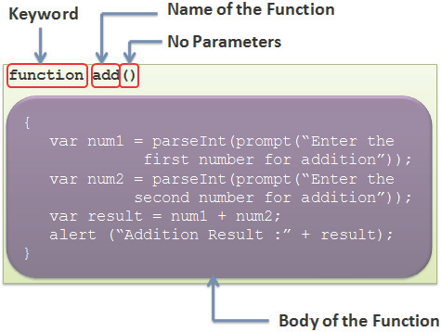
Declaring and Defining Functions
Syntax to create a function in JavaScript is as follows:
function function_name(list of parameters)
{
// Body of the function
}

Slide 5
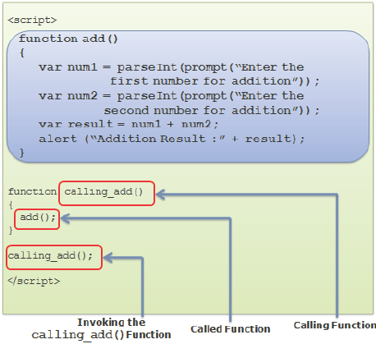
Invoking Functions
A function need to be invoked or called to execute it in the browser.
To invoke a function, specify the function name followed by parenthesis outside the function block.

Slide 6
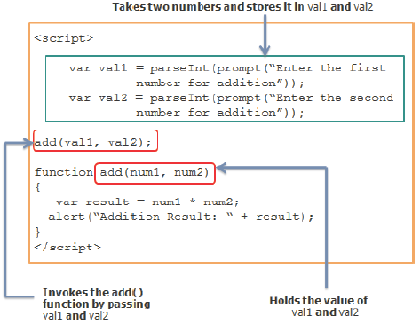
Parameterized Functions
Parameterized Functions
Can be created when there is a need to accept values from the user
Parameters hold values on which the function needs to perform operations

Slide 7
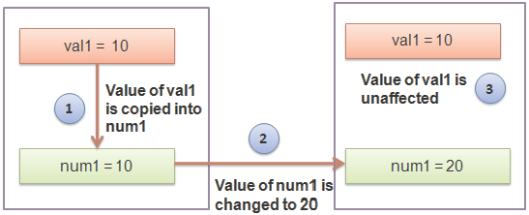
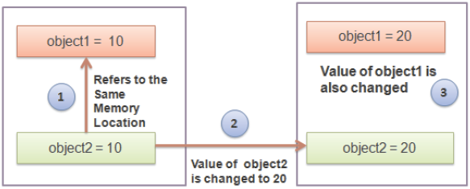
Ways of Passing Arguments
Passing by value - Refers to passing variables as arguments to a function. Called function do not change the values of the parameters passed to it from the calling function.
Passing by reference - Refers to passing objects as arguments to a function.

Slide 8
return Statement
Returns the control to the calling function because of unexpected results
return Statement
Can also be used to halt the execution of the function
Allows sending the result back to the calling function
Begins with return keyword followed by the variable or value

Slide 9
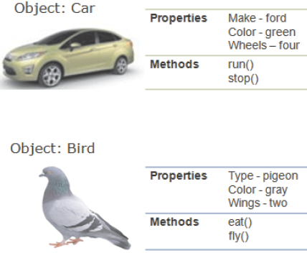
Objects
Are entities with properties and methods and resemble to real life objects.
Properties specify the characteristics or attributes of an object.
Methods identify the behavior of an object.

Slide 10
Creating Custom Objects 1-2
Direct Method
var object_name = new Object();
where,
object_name: Is the name of the object.
new: Is the keyword that allocates memory to the custom object. This is known as instantiation of an object.
object: Is the built-in JavaScript object that allows creating custom objects.
Template Method
var obj_name = new object_type(list of arguments);
<script>
//create an object using direct method
var doctor = new Object();
//create an object using template method
var st = new Student(‘James’, ‘23’, ‘New Jersey’);
</script>

Slide 11
Creating Custom Objects 2-2
Constructor function:
A constructor function is a reusable block that specifies the type of object, its properties, and its methods.
It might or might not take any parameters.
When an object is initialized by new keyword: memory will be allocated to it and constructor function will be invoked.
Syntax to create a constructor function is as follows:
function object_type(list of parameters)
{
// Body specifying properties and methods
}

Slide 12
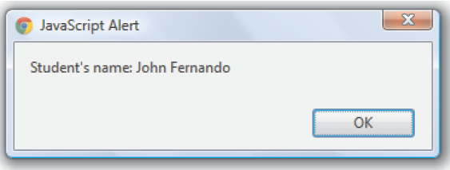
Creating Properties for Custom Objects 1-2
Properties specify the characteristics of an object.
To access a property of an object, specify the object name followed by a period and the property name.
The Code Snippet demonstrates the script that creates the student object and properties by direct method
<script>
var student_details = new Object();
student_details.first_name = ‘John’;
student_details.last_name = ‘Fernando’;
student_details.age = ‘15’;
alert(‘Student\’s name: ‘
+ student.first_name
+ ‘ ‘ +student.last_name);
</script>

Slide 13
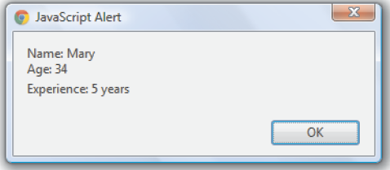
Creating Properties for Custom Objects 2-2
The Code Snippet creates the employee object and adds properties in the constructor function.
<script>
// To define the object type
function employee(name, age, experience)
{
this.name = name;
this.age= age;
this.experience= experience;
}
// Creates an object using new keyword
var emp = new employee(‘Mary’, ‘34’, ‘5 years’);
alert(“ Name: “+ emp.name + “\n Age: “+emp.age+
”\n Experience: “+emp.experience);
</script>

Slide 14
Creating Methods for Custom Objects
Methods are similar to JavaScript functions.
A method is associated with an object and is executed by referring to that object but a function is executed independently.
To invoke a method, it must be specified with the object name followed by a period, method name, and parenthesis with parameters, if any.
The Code Snippet demonstrates the script that defines a custom method.
<script>
var square = new Object();
square.length = 5;
square.cal_area = function() {
return square.length * square.length;
}
alert(“Area: “ + square.cal_area());
</script>

Slide 15
Built-in Objects
Object model of JavaScript forms the foundation of the language.
These objects help to provide custom functionalities in the script.
JavaScript treats the primitive data types as objects and provide equivalent object for each of them.
JavaScript objects are categorized as built-in objects, browser objects, and HTML objects.
Built-in objects are static objects which can be used to extend the functionality in the script.
Browser objects, such as window, history, and navigator are used to work with the browser window.
HTML objects, such as form, anchor, and so on are used to access elements on the Web page.

Slide 16
String Object 1-2
is a set of characters that are surrounded by single or double quotes.
allows you to perform different text operations on them.
is instantiated with the new keyword
Syntax :
var object_name = new String(“Set of characters”) ;
Following table lists properties of the String object.
Property | Description
length | Retrieves the number of characters in a string.
prototype | Adds user-defined properties and methods to the String instance.

Slide 17
String Object 1-2
Following table lists the methods of the String object.
^{Method} | ^{Description}
charAt() | Retrieves a character from a particular position within a string.
concat() | Merges characters from one string with the characters from another string and retrieves a single new string.
indexOf() | Retrieves the position at which the specified string value first occurred in the string.
lastIndexOf() | Retrieves the position at which the specified string value last occurred in the string.
replace() | Matches a regular expression with the string and replaces it with a new string.
search() | Searches for a match where the string is in the same format as specified by a regular expression.
split() | Divides the string into substrings and defines an array of these substrings.
substring() | Retrieves a part of a string between the specified positions of a string.
toLowerCase() | Specifies the lowercase display of the string.

Slide 18
Math Object
allows the user to perform mathematical operations on numeric values.
provides static properties and methods to perform mathematical operations.
Properties and methods are declared as static, thus they can be invoked directly with the object name.
Syntax to access the properties of the Math object :
var variable = Math.PropertyName;
Example:
var pi = Math.PI;
Syntax to invoke the methods of the Math object :
var variable = Math.MethodName(optional parameters);
Example:
var x = Math.sqrt(26);

Slide 19
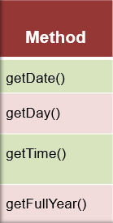
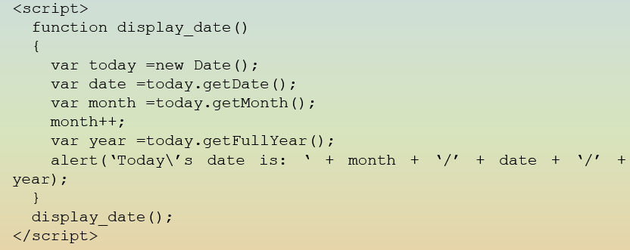
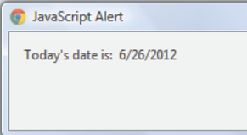
Date Object
allows to define and manipulate the date time values programmatically.
Syntax to instantiate the Date object is as follows:
var object_name = new Date();
var object_name = new Date(milliseconds);
var object_name = new Date(year,month,day,hour,minutes, seconds, milliseconds);
var object_name = new Date(“dateString”);

Slide 20
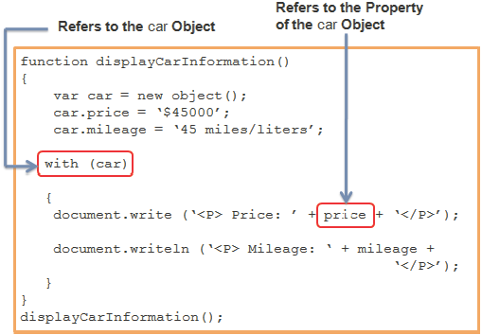
with Statement
allows to remove the object reference for each JavaScript statement.
starts with the with keyword followed by the open and close brackets, which holds the statements that refer to a common object.
increases the readability of the code and also reduces time required in writing each object reference in every related statement.
Syntax to declare the with statement is as follows:
with(object_name)
{
//Statements
}

Slide 21
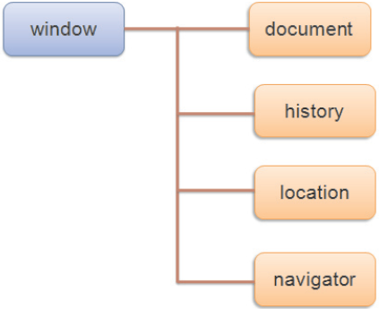
Browser Objects
Allow to access and manipulate various aspects of the Web browser.
These following objects are called as browser objects:
Notes:
http://www.w3schools.com/js/js_ex_browser.asp

Slide 22
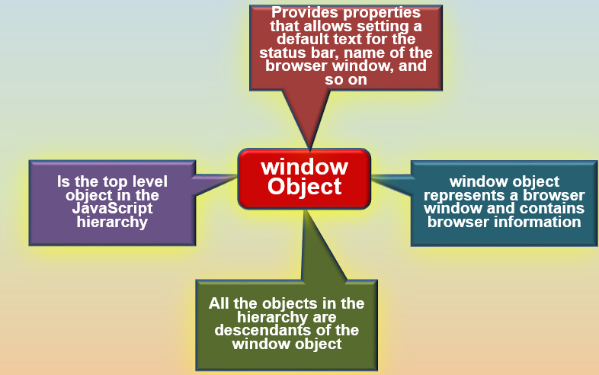
window Object
Property
defaultStatus
document
history
location
Method
alert()
confirm()
createPopup()
focus()
open()
prompt()

Slide 23
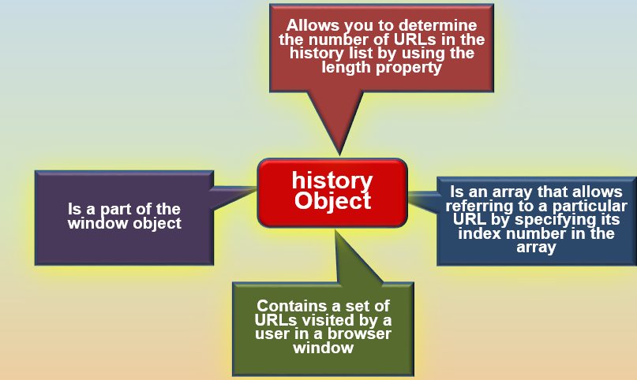
history Object
^{Method}
back()
forward()
go()

Slide 24
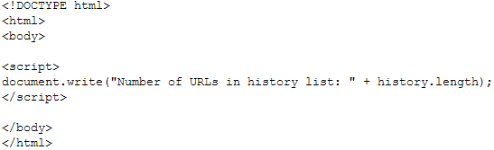
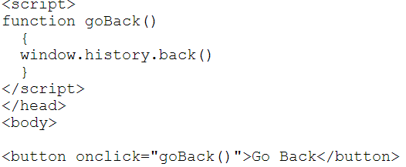
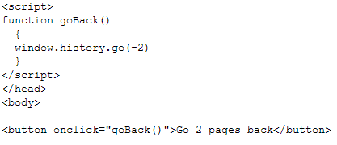
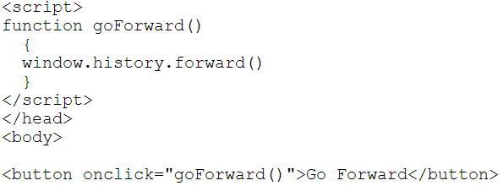
history Object

Slide 25
navigator Object
navigator object
Contains information about the browser used by the client
Allows the user to retrieve information, such as name, version number, and so on
Following table lists the properties of the navigator object.
Property | Description
appName | Retrieves the name of the browser.
appVersion | Retrieves the version number and platform of the browser.
browserLanguage | Retrieves the language of the browser.
cookieEnabled | Determines whether the cookies are enabled in the browser.
platform | Retrieves the machine type such as Win32, of the client browser.

Slide 26
location Object
Allows to access complete information of the URL loaded in the browser window
location object
Is a part of the Window object
Following table lists the properties and methods of the location object.
Property/Method | Description
host | Retrieves hostname and port number of the URL.
href | Specifies or retrieves the entire URL.
pathname | Specifies or retrieves the path name of the URL.
assign() | Loads a new document with the specified URL.
reload() | Reloads the current document by again sending the request to the server.
replace() | Overwrites the URL history for the current document with the new document.

Slide 27
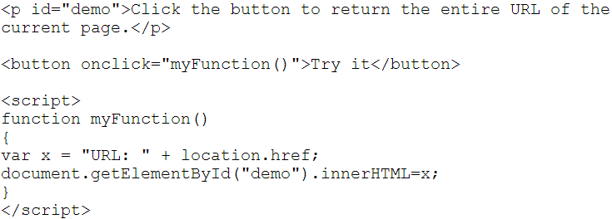
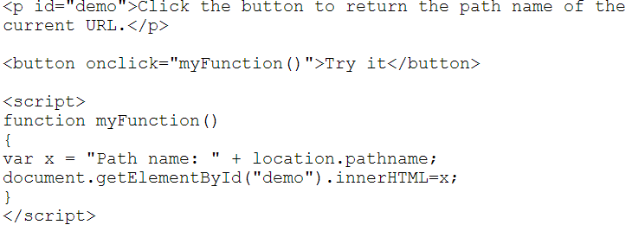
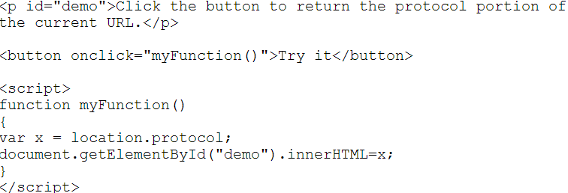
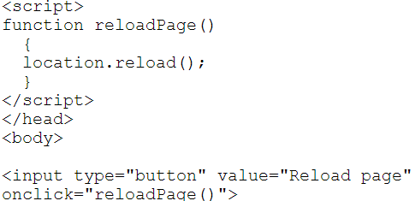
location Object

Slide 28
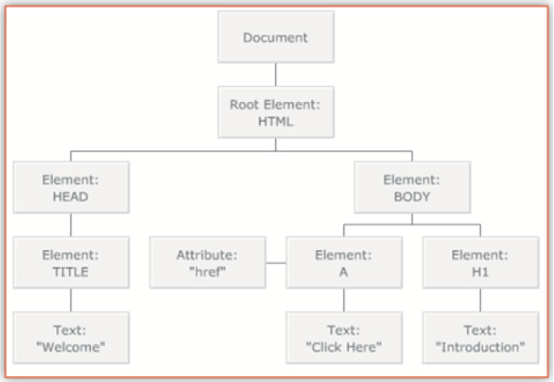
Document Object Model 1-2
JavaScript allows the user to access HTML elements and also change the existing structure of an HTML page by using Document Object Model (DOM) specification.
DOM is an Application Programming Interface (API) that defines the object structure for accessing and manipulating HTML elements.
DOM is used with JavaScript to add, modify, or delete elements and contents on the Web page.

Slide 29
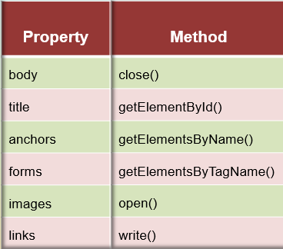
Document Object Model 2-2
All the nodes contain properties that provide information about the node.
The note properties are as follows:
nodeName - name of the node. It contains the tag name of the HTML element in upper case.
nodeValue - text contained within the node. This property is only available for attribute nodes and not for document and element nodes.
nodeType - type of the node. For example, the document node, element node...
HTML DOM provides standard objects for HTML documents and some of these are as follows:
Document object
Form object
Link object
Table object

Slide 30
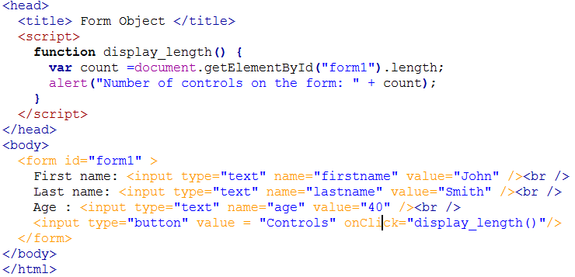
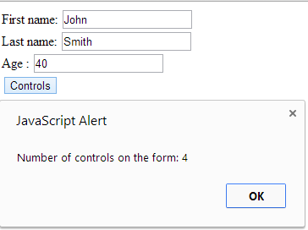
Form Object
Accepts input from the user and sends the user data for validation.
A single HTML document can contain multiple forms.
DOM specification provides a form object that represents an HTML form which is created for each <form> tag.

Slide 31
Summary
A function is reusable piece of code, which performs calculations on parameters and other variables.
The return statement passes the resultant output to the calling function after the execution of the called function.
Objects are entities with properties and methods and resemble to real life objects.
There are two ways to create a custom object namely, by directly instantiating the Object object or by creating a constructor function.
JavaScript provides various built-in objects, such as String, Math, and Date.
JavaScript also provides browser objects, such as window, history, location, and navigator.
DOM is a standard technique for dynamically accessing and manipulating HTML elements. The DOM provides a document object which is used within the JavaScript to access all HTML elements presented on the page.

